Slide 1

BDAT 1007 Social Data Mining Techniques
Assignment #1
Presented By:
Aryaman Chaudhary
Brunilda Xhaferllari
Harmilap Singh Dhaliwal
Mukesh Kumar
Notes:
Tripadvisor icon: https://www.stickpng.com/img/download/5a05b78d9cf05203c4b60465
PPT presentation: Slidesgo

Slide 2

TABLE OF CONTENTS
01
02
03
Presenting the Team
Our Topic
Tools and Techniques
04
05
Data Model & Web Scraping
App design
Quick presentation of team and their responsibilities
More than 100 location to visit in Canada with TripAdvisor
More than 10 tools and techniques for this project
06
CRUD Functionality
Web Scraping proccess step by step for 15 variables
Combines the user interface (UI) & user experience (UX)
Create, Read, Update and Delete

Slide 3




Our Team
Brunilda Xhaferllari
Aryaman Chaudhary
Harmilap Singh Dhaliwal
Business Analyst
Python Developer
Mukesh Kumar
Web Developer
Web Developer

Slide 4
Why TripAdvisor?
TripAdvisor with 465 million review today, make the site a major draw for travelers
TripAdvisor is the world's largest travel site, allowing travelers to take full advantage of every trip
Let’s explore best places to visit in Toronto Today!
American online travel company that operates a website and mobile app with revenue more than $1560 billion
International travel restrictions during the COVID-19 pandemic have prompted many travel enthusiasts to explore local and regional tourist destinations.
Data Source
https://www.tripadvisor.in/Attractions-g155019-Activities-a_allAttractions.true-Toronto_Ontario.html
Notes:
Information Source :
https://www.barrons.com/articles/why-tripadvisor-is-getting-a-bad-review-1487266932
https://support.theforkmanager.com/s/article/What-are-the-advantages-of-a-TripAdvisor-profile?language=en_US
https://theconversation.com/the-covid-19-pandemic-has-created-regional-tourism-hotspots-as-big-cities-suffer-159892

Slide 5




Tools and Techniques
Beautiful Soup
Flask
Selenium
Python library used for web scraping of data of 15 variables
Python library and tool used for automating web browsers using webdriver to extract Website, Phone and Email
Mongo DB Atlas
Database program used to parse all the information from best places to visit in Toronto
Python web framework used for developing web application
Notes:
Icon: https://funthon.wordpress.com/2017/05/21/beautiful-soup-4/
Icon: https://www.blazemeter.com/devops-news/blazemeter-supports-selenium-webdriver-technology
Icon: https://www.cleanpng.com/png-mongodb-database-nosql-postgresql-mongo-4631237/
Icon: https://www.pngkey.com/download/u2q8y3w7a9a9w7u2_flask-logo-flask-python-icon/

Slide 6







Tools and Techniques
Adds dynamic content to Web App design with JavaScript
Creating fast and dynamic web page with Ajax technique
Create the primary structure of the Web Design in HTML
jQuery a tool that helps to simplify interactions between JS and HTML elements
Front-end framework as Bootstrap to create better web application
Define the style of Web App Design with CSS
Notes:
Icon: https://artandlogic.com/2016/04/caching-binary-data-jquery-ajax-indexeddb/
Icon: https://www.pngix.com/downimg/Jmwmih_computer-icons-logo-brand-javascript-angle-javascript-logo/
Icon: https://www.vhv.rs/download/homwbwi_jquery-logo-png-transparent-png/
Icon: https://www.pngkey.com/download/u2q8i1o0e6u2a9o0_we-help-you-to-solve-any-issues-or/
Icon: https://www.pngitem.com/download/miRbJ_transparent-curly-brackets-png-transparent-css-icon-png/
Icon: https://www.stickpng.com/img/download/5848152fcef1014c0b5e4967

Slide 7
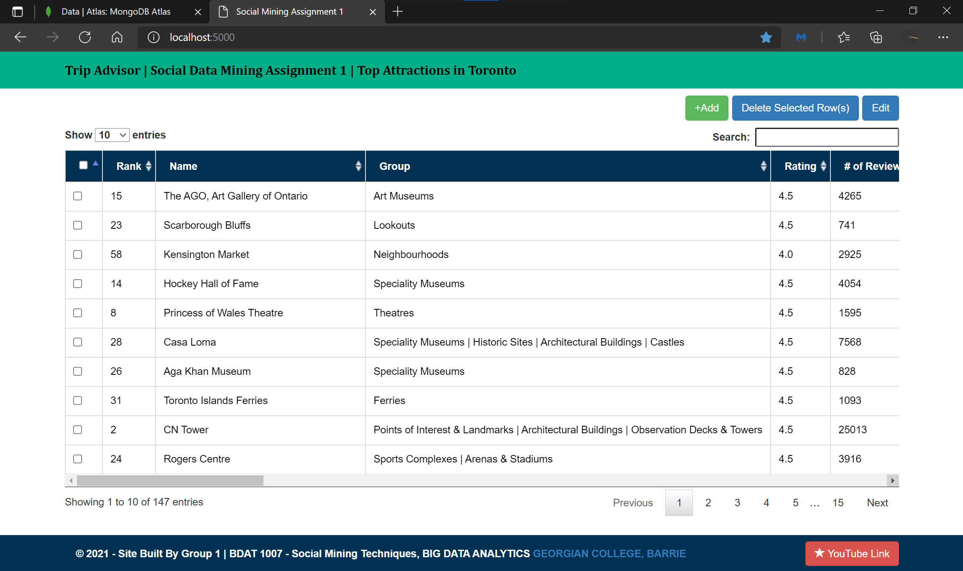

Slide 8
Data Model

Slide 9
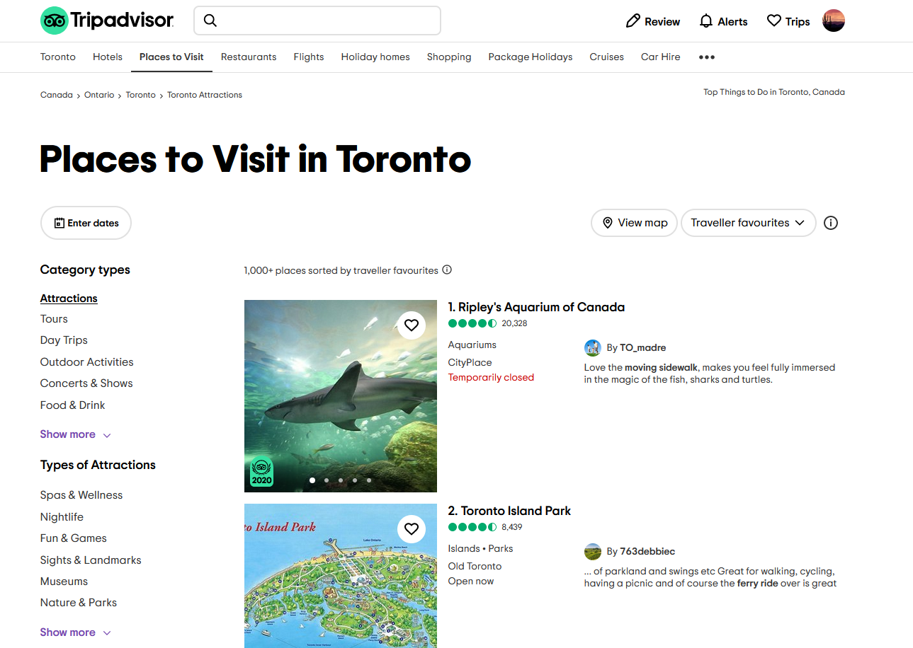
Data Model
Data Source
Sr.No. | Variable Name
1 | Name
2 | Rank
3 | Group
4 | Open
5 | Timings
6 | Website
7 | Phone
8 | Email
9 | Summary
10 | Suggested Duration
11 | Address
12 | Neighbourhood
13 | Rating
14 | # of Reviews
15 | Perfect Reviews %
16 | Website_link
17 | timeScraped
https://www.tripadvisor.in/Attractions-g155019-Activities-a_allAttractions.true-Toronto_Ontario.html

Slide 10
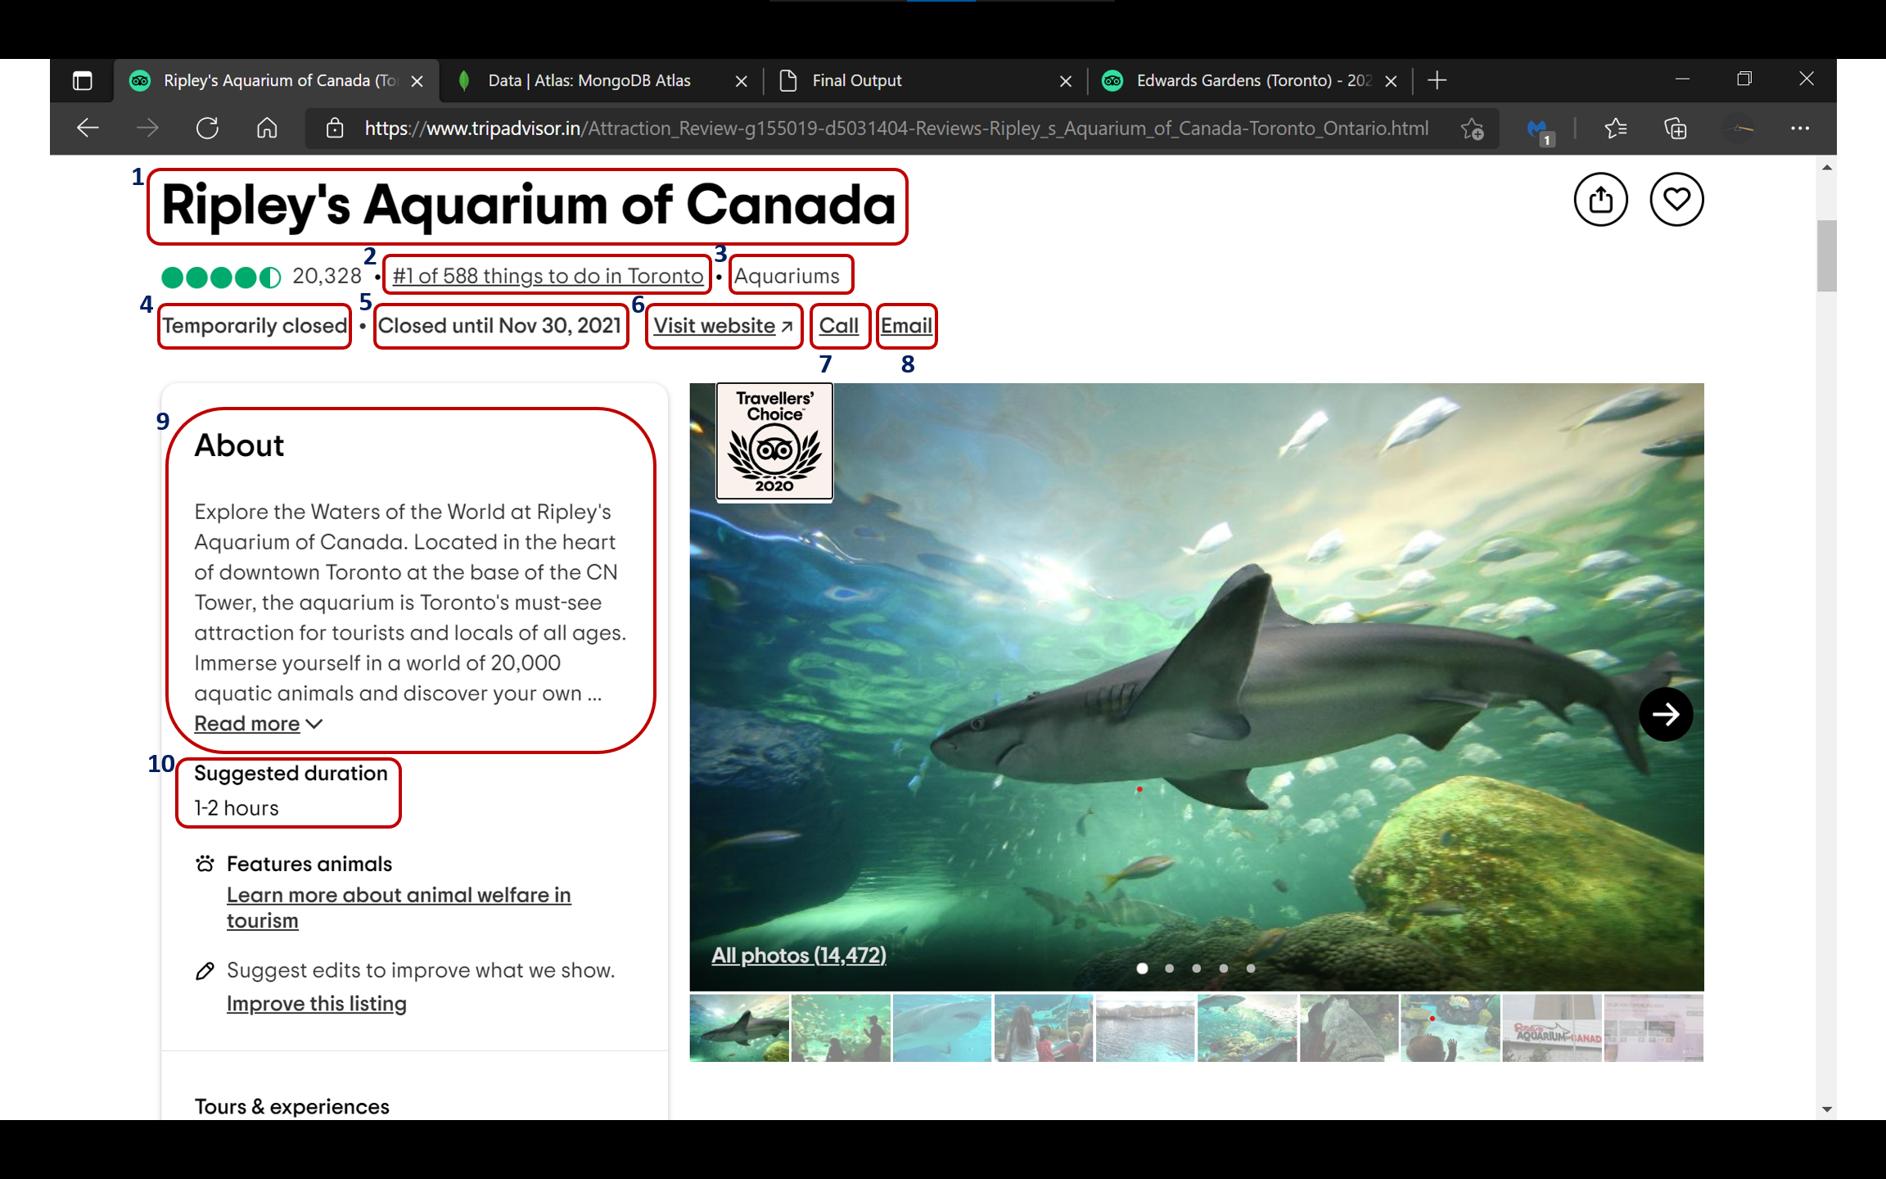
Data Model
Sr.No. | Variable Name
1 | Name
2 | Rank
3 | Group
4 | Open
5 | Timings
6 | Website
7 | Phone
8 | Email
9 | Summary
10 | Suggested Duration

Slide 11
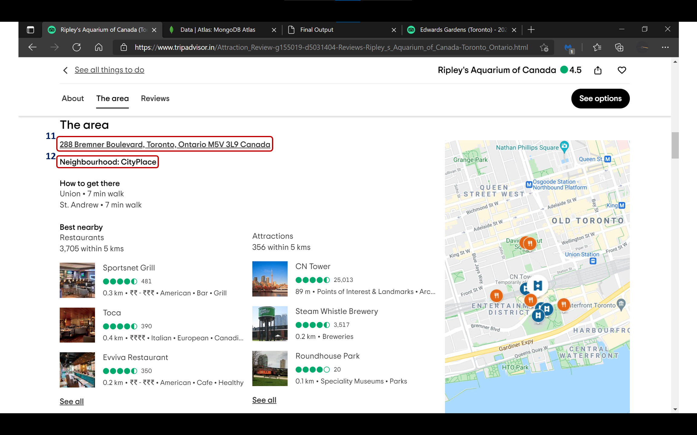
Data Model
Sr.No. | Variable Name
11 | Address
12 | Neighbourhood

Slide 12
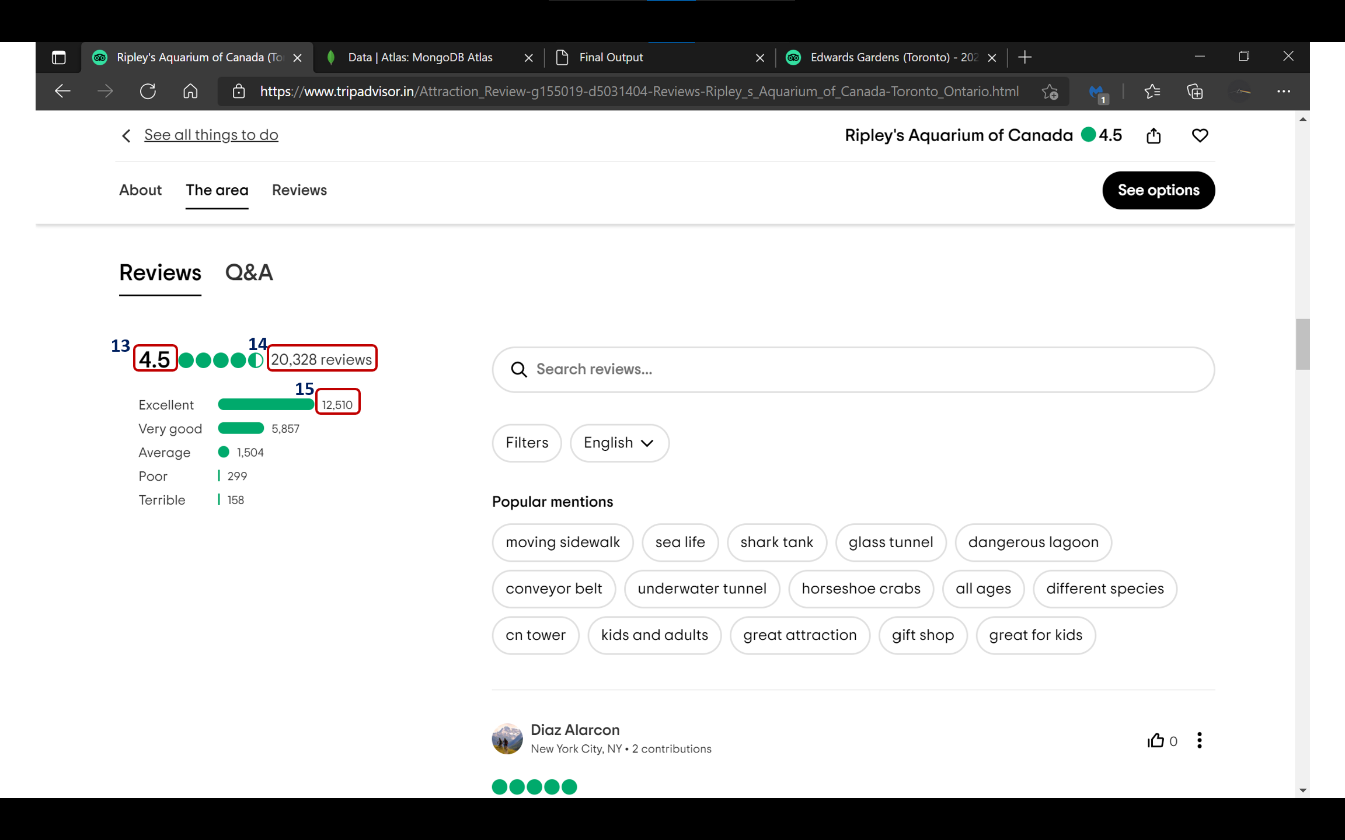
Data Model
Sr.No. | Variable Name
13 | Rating
14 | # of Reviews
15 | Perfect Reviews %

Slide 13
Web Scraping

Slide 14
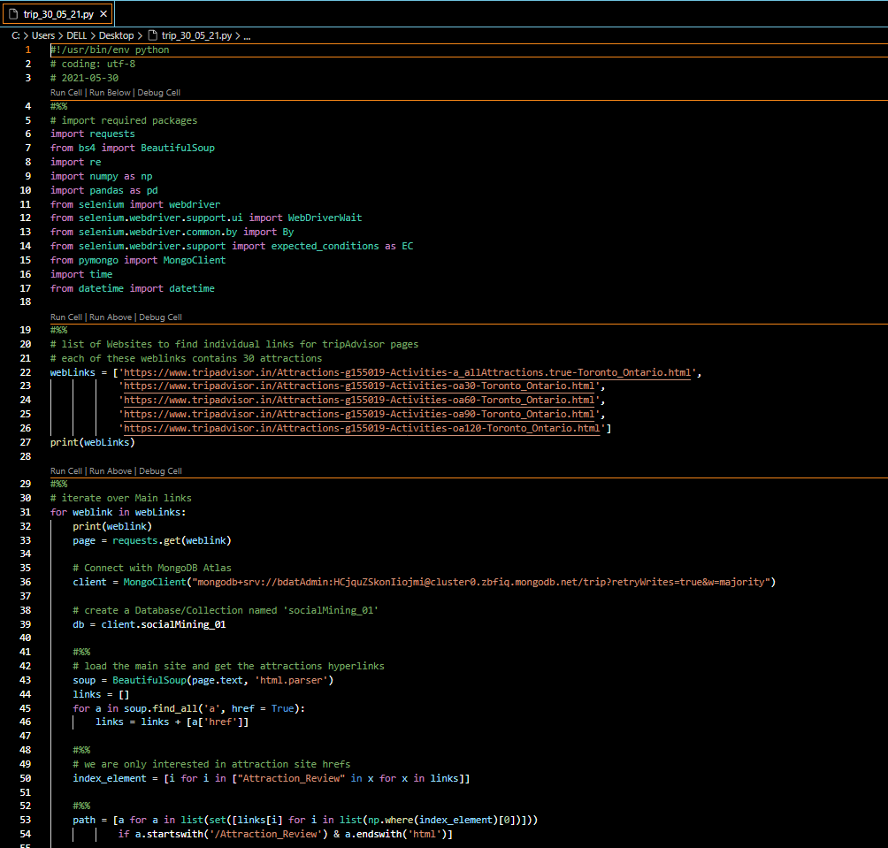
Coding For Web Scarping Part 1
Notes:
Image: https://brandslogos.com/wp-content/uploads/images/large/tripadvisor-logo-black-and-white-1.png

Slide 15
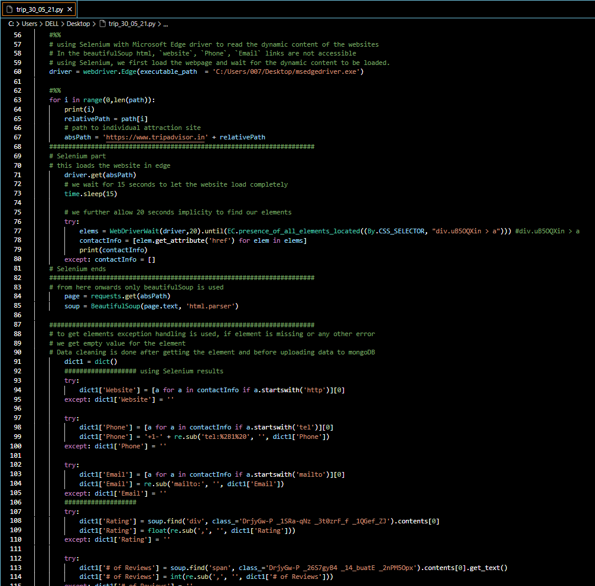
Coding For Web Scarping Part 2

Slide 16
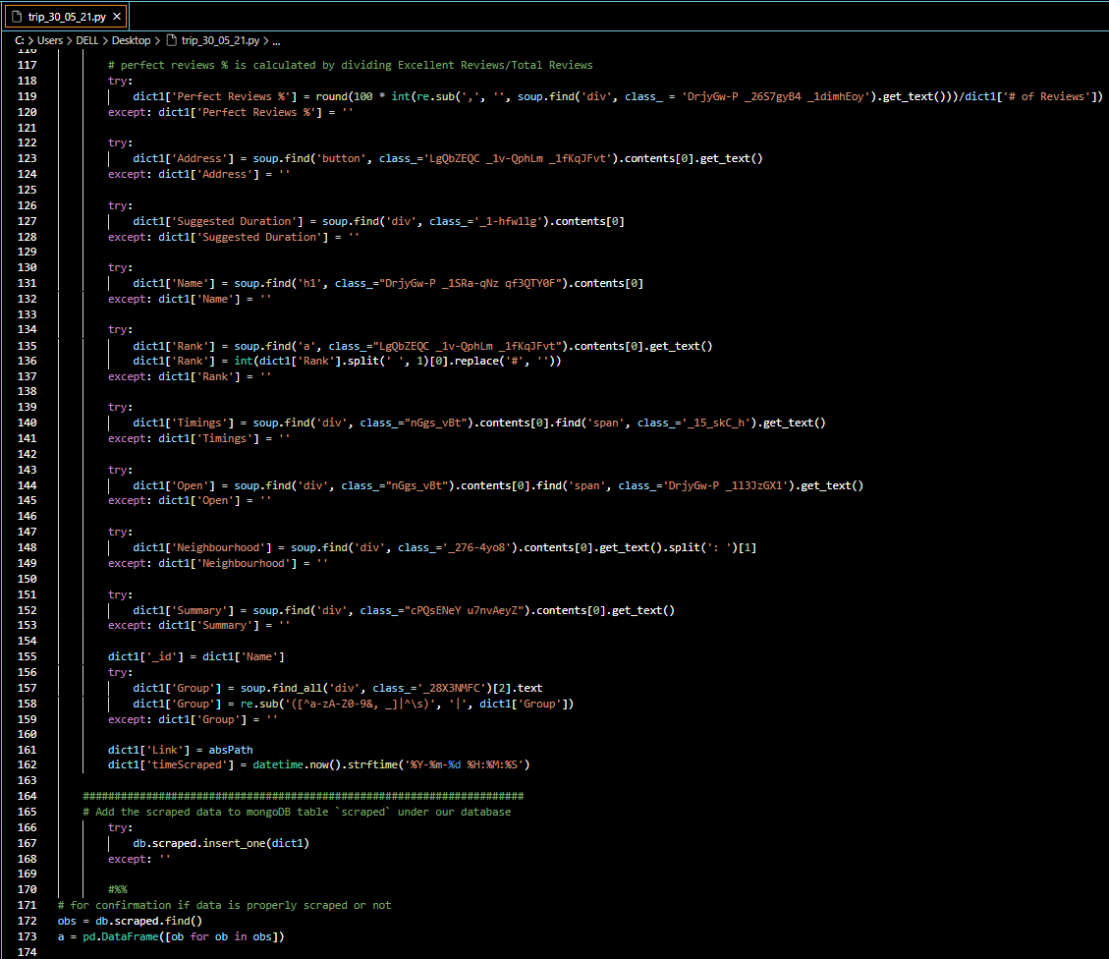
Coding For Web Scarping Part 3

Slide 17
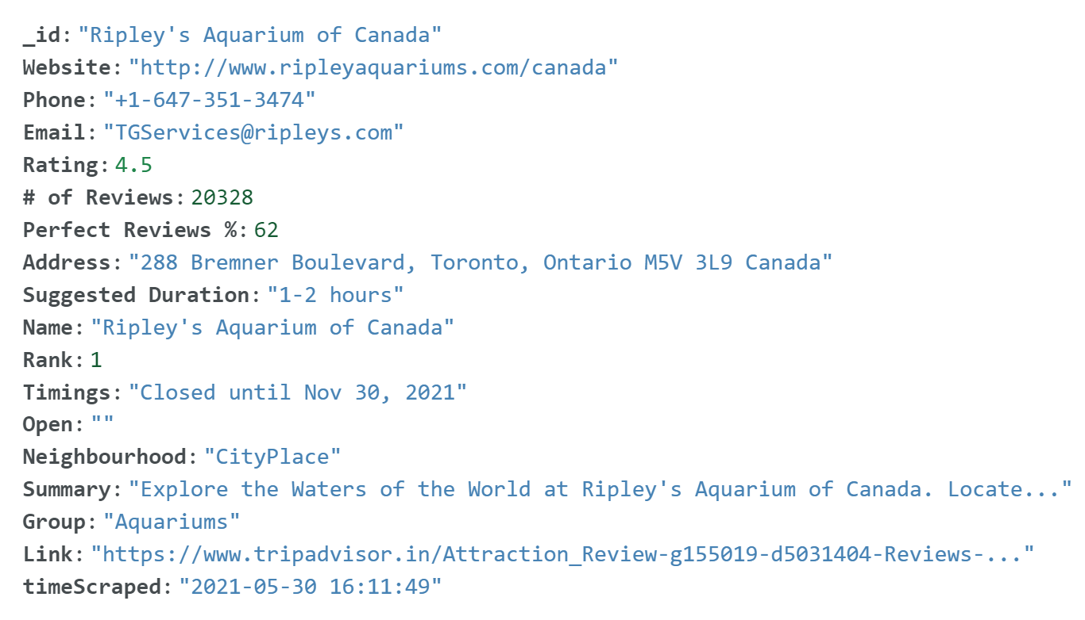
MongoDB Atlas Sample Entry

Slide 18
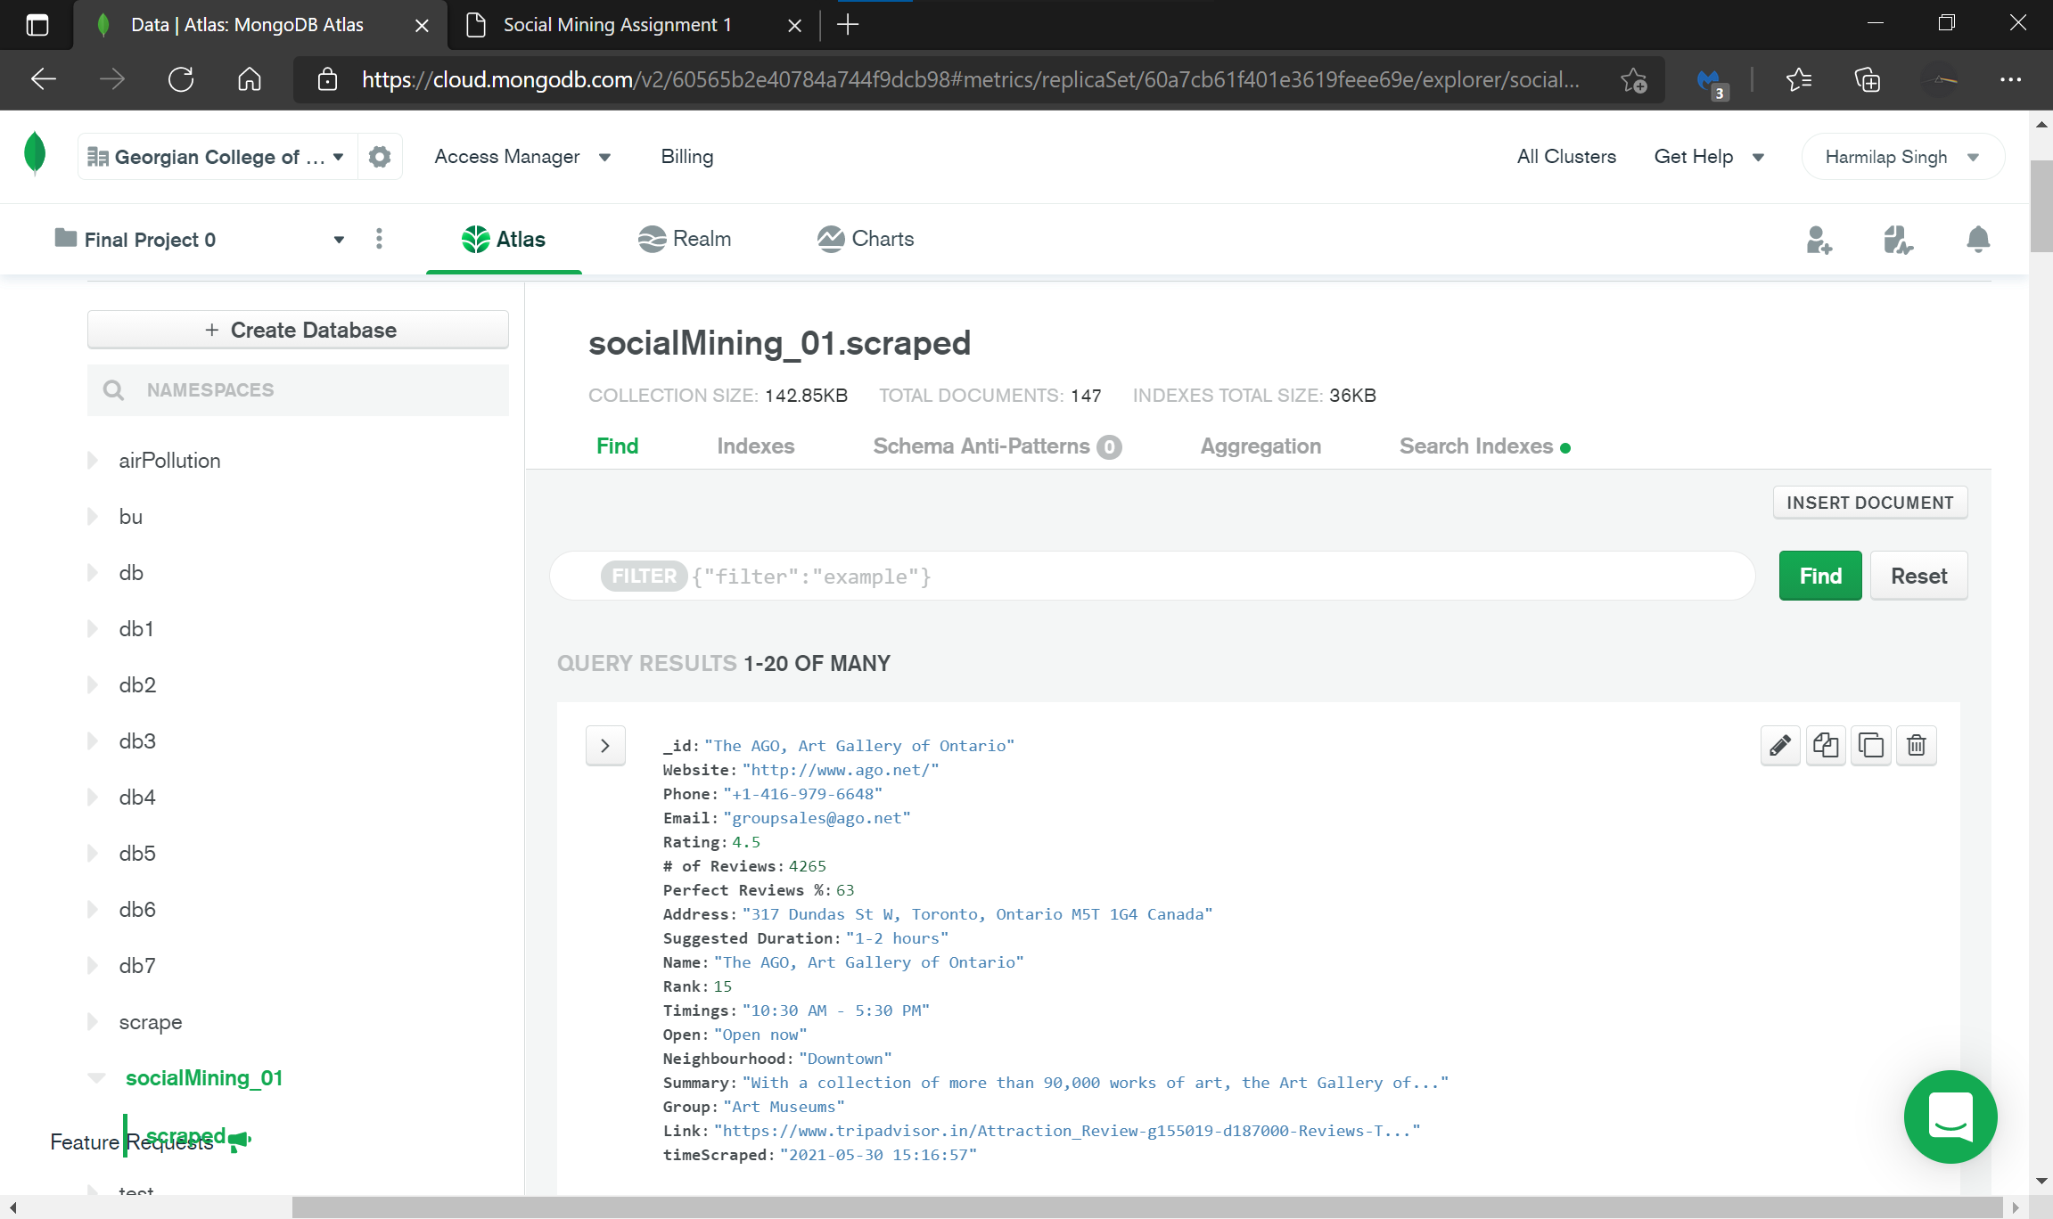
MongoDB Atlas Sample Entry

Slide 19
Web App

Slide 21
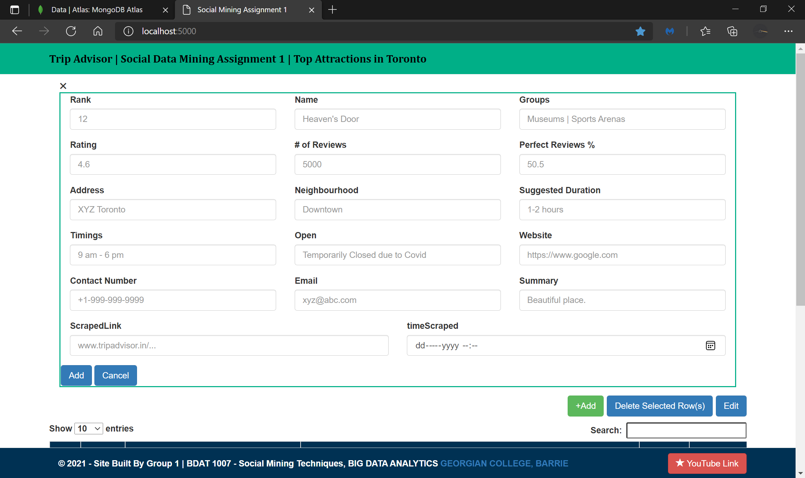

Slide 22
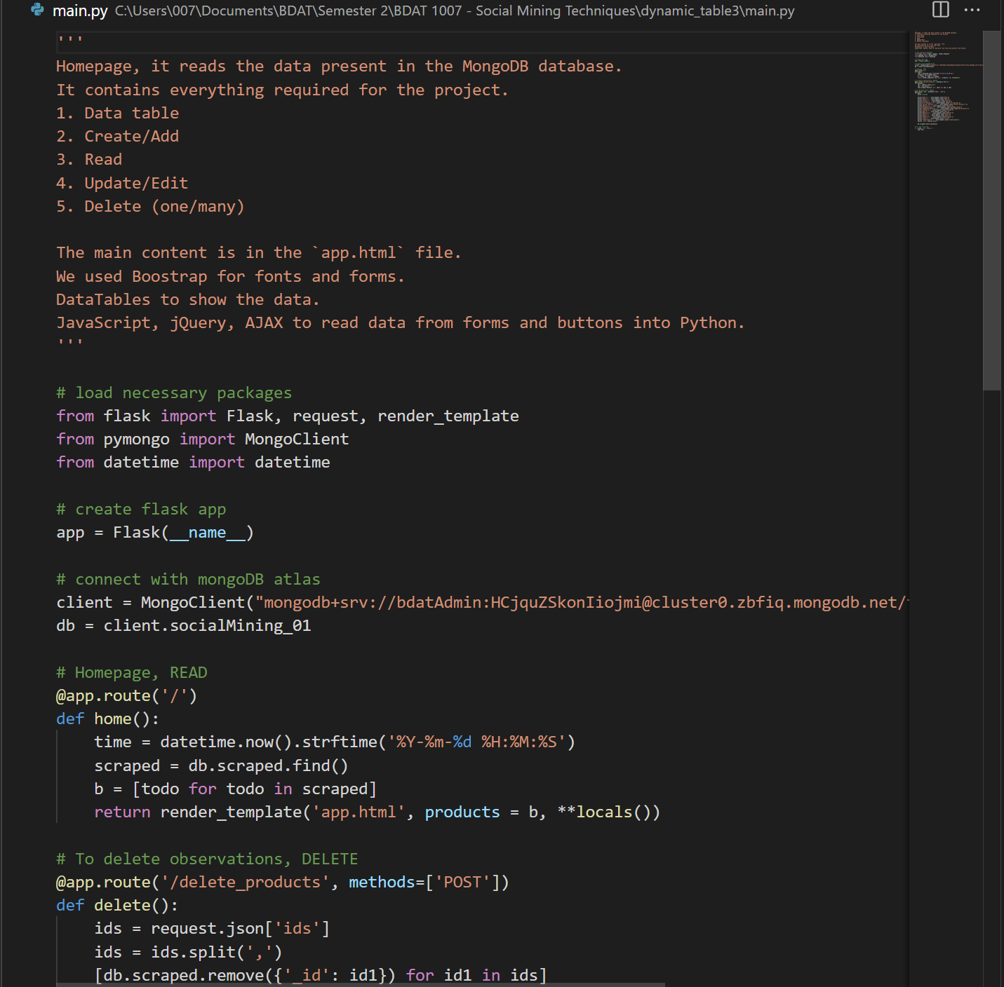
Backend For Web App Part 1

Slide 23
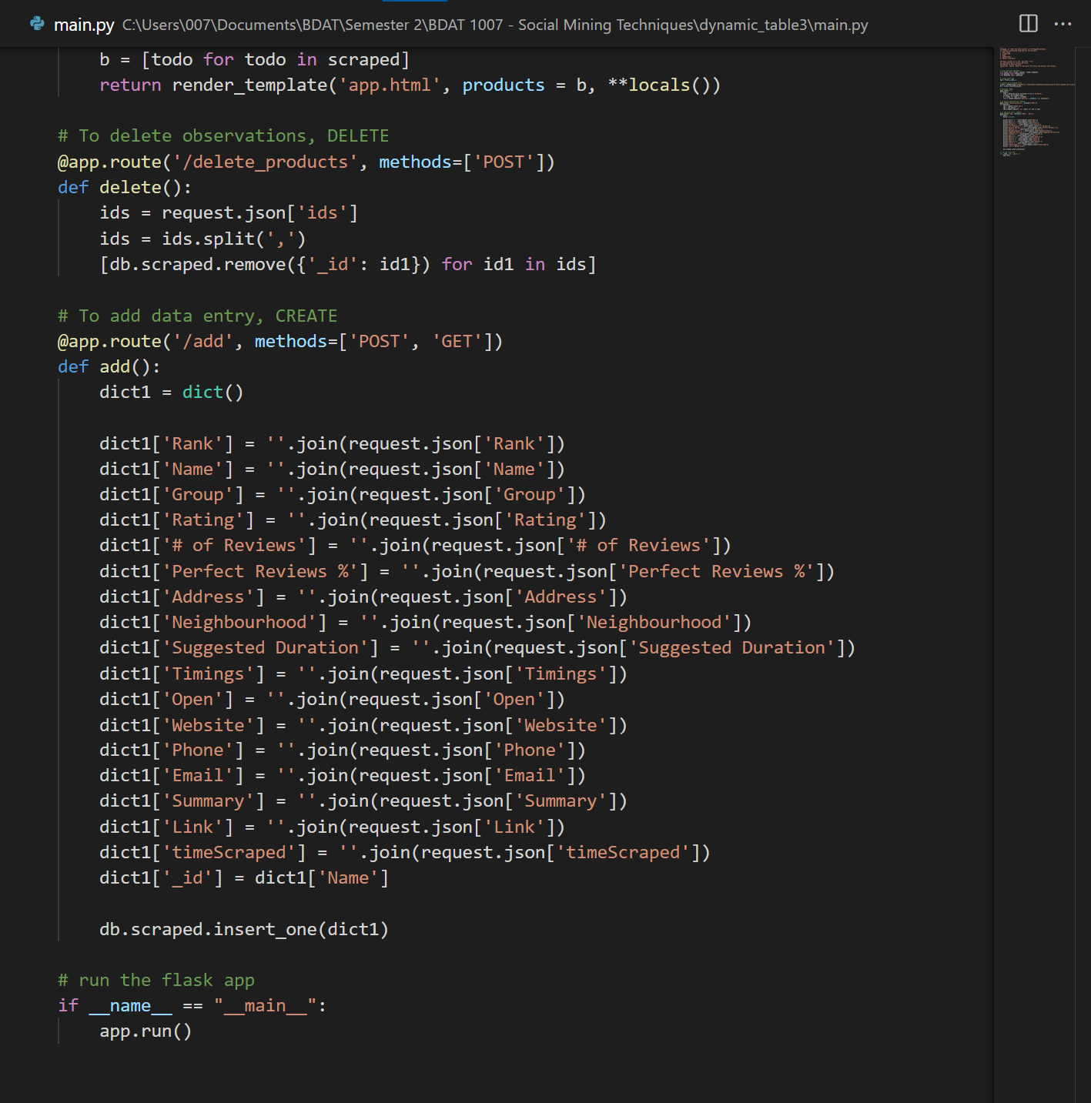
Backend For Web App Part 2

Slide 24
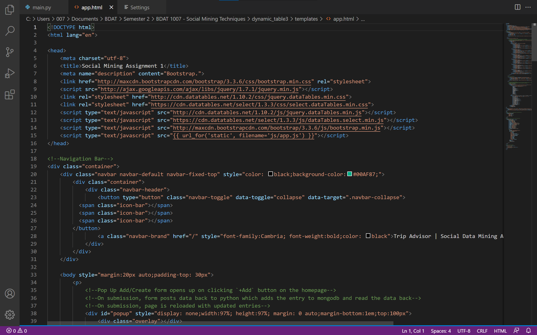
Front End For Web App Part 1

Slide 25
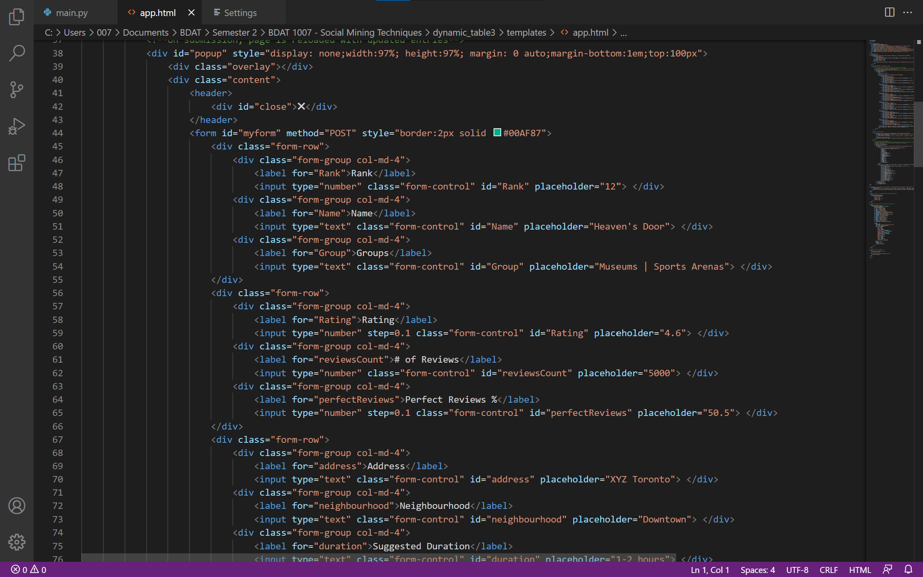
Front End For Web App Part 2

Slide 26
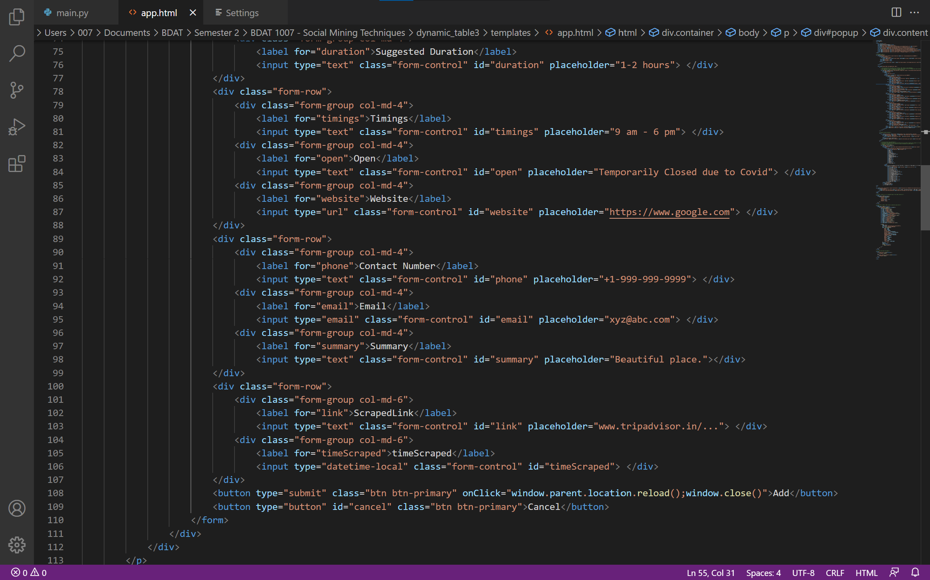
Front End For Web App Part 3

Slide 27
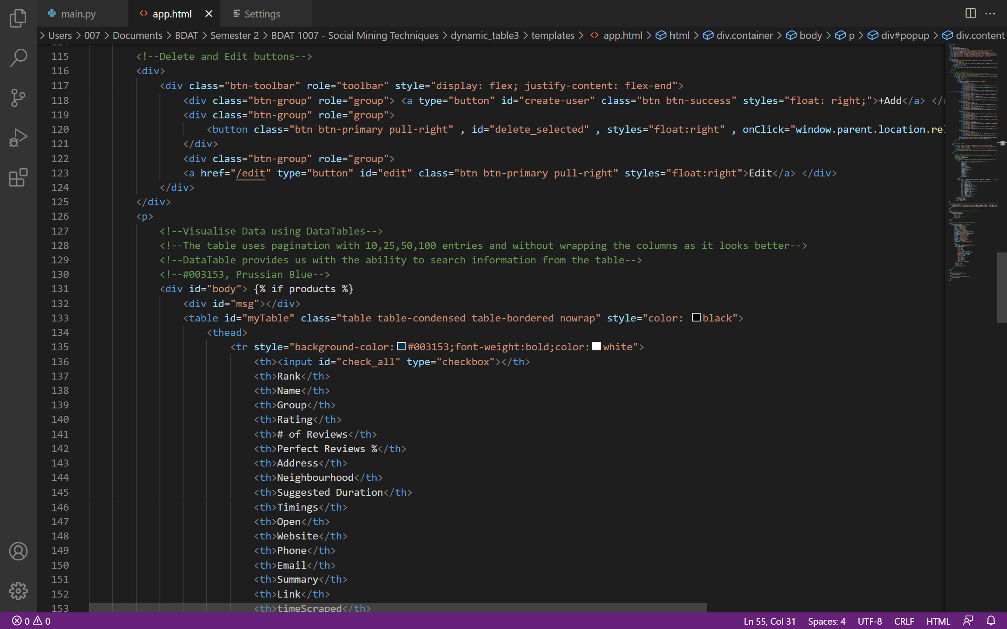
Front End For Web App Part 4

Slide 28
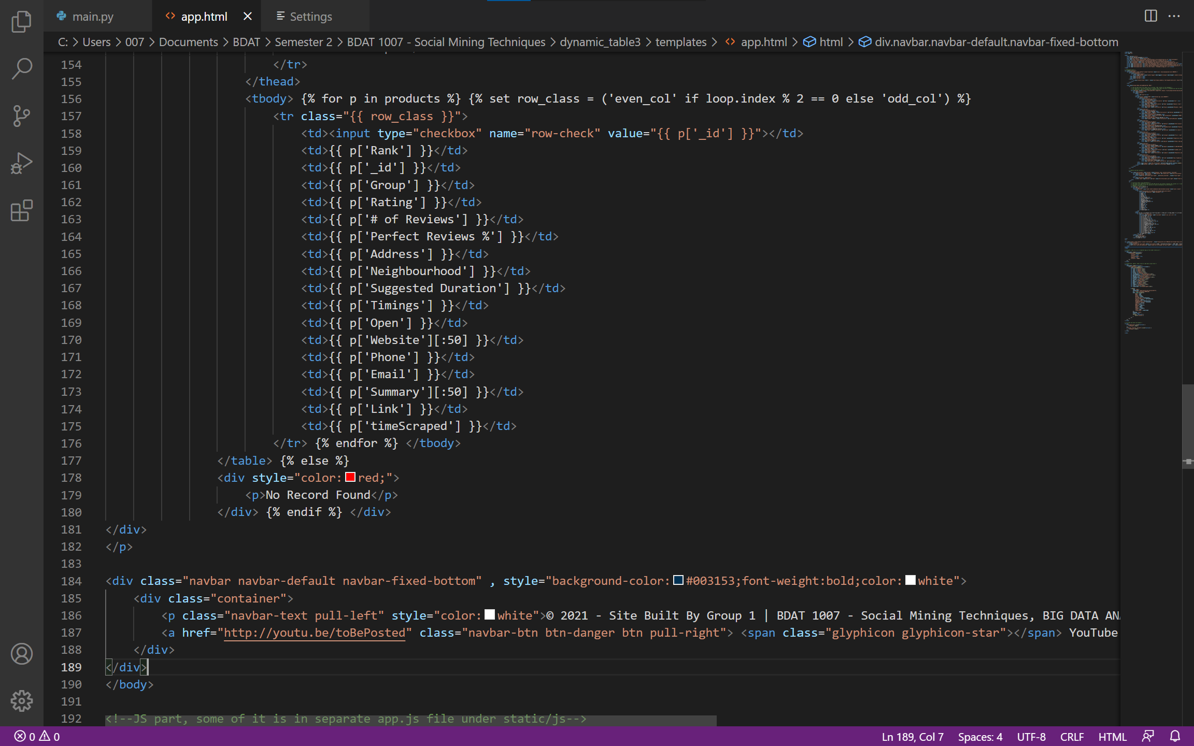
Front End For Web App Part 5

Slide 29
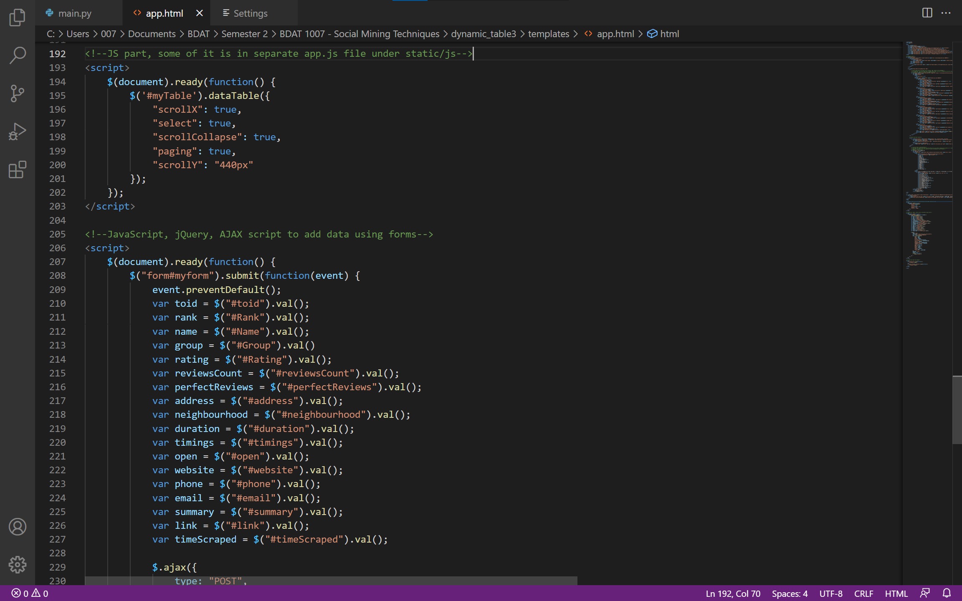
Front End For Web App Part 6

Slide 30
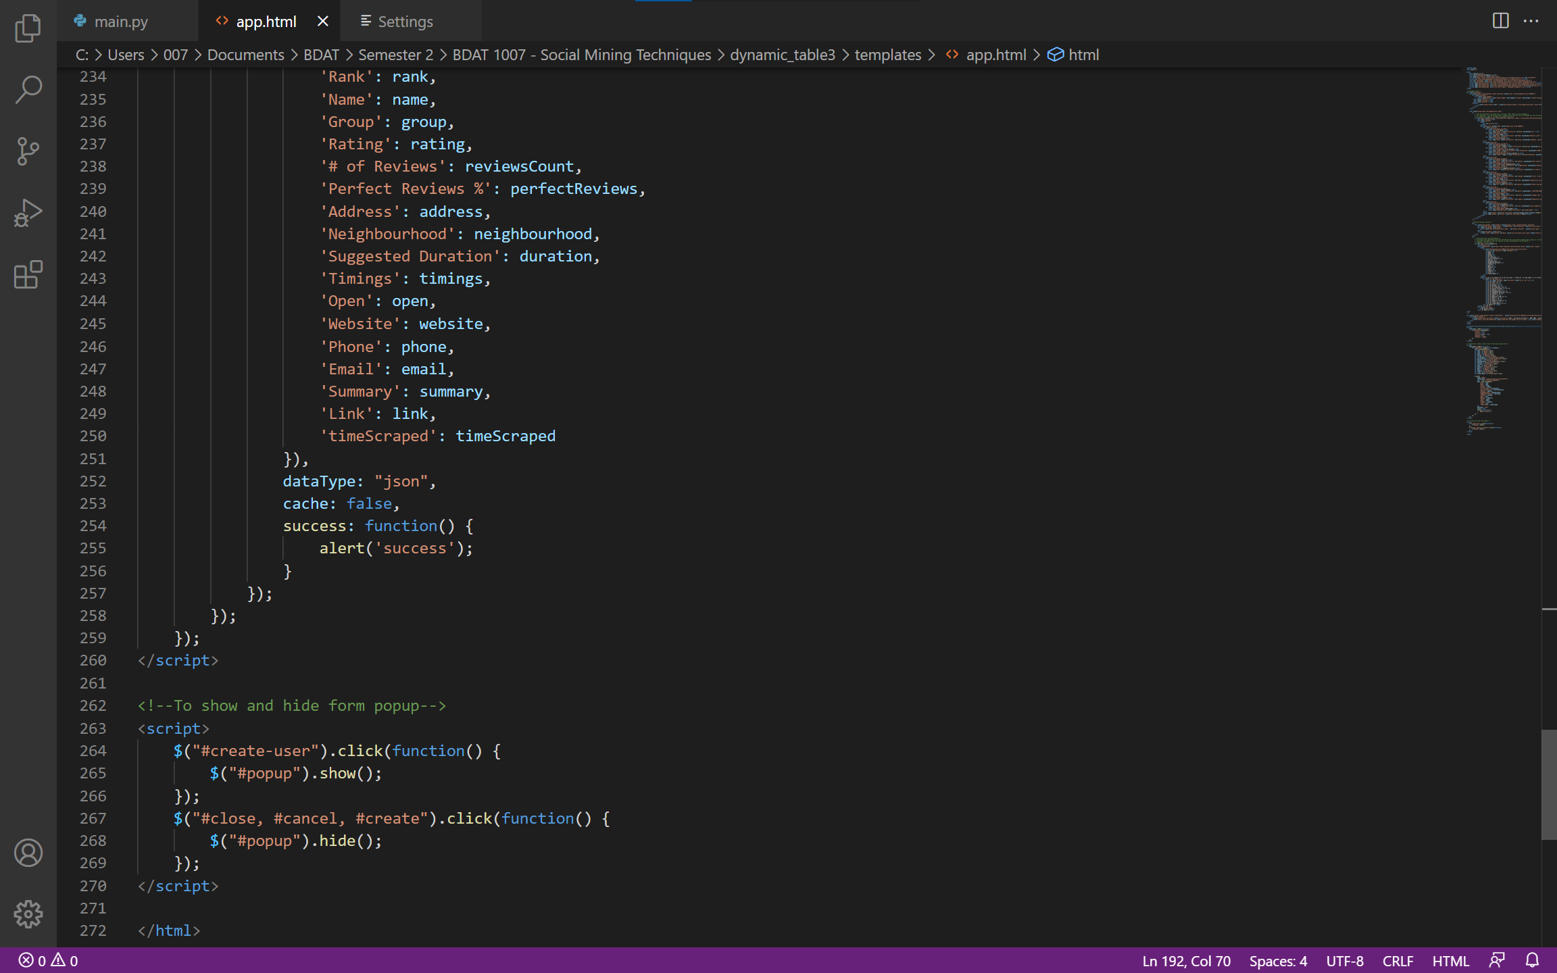
Front End For Web App Part 7

Slide 31
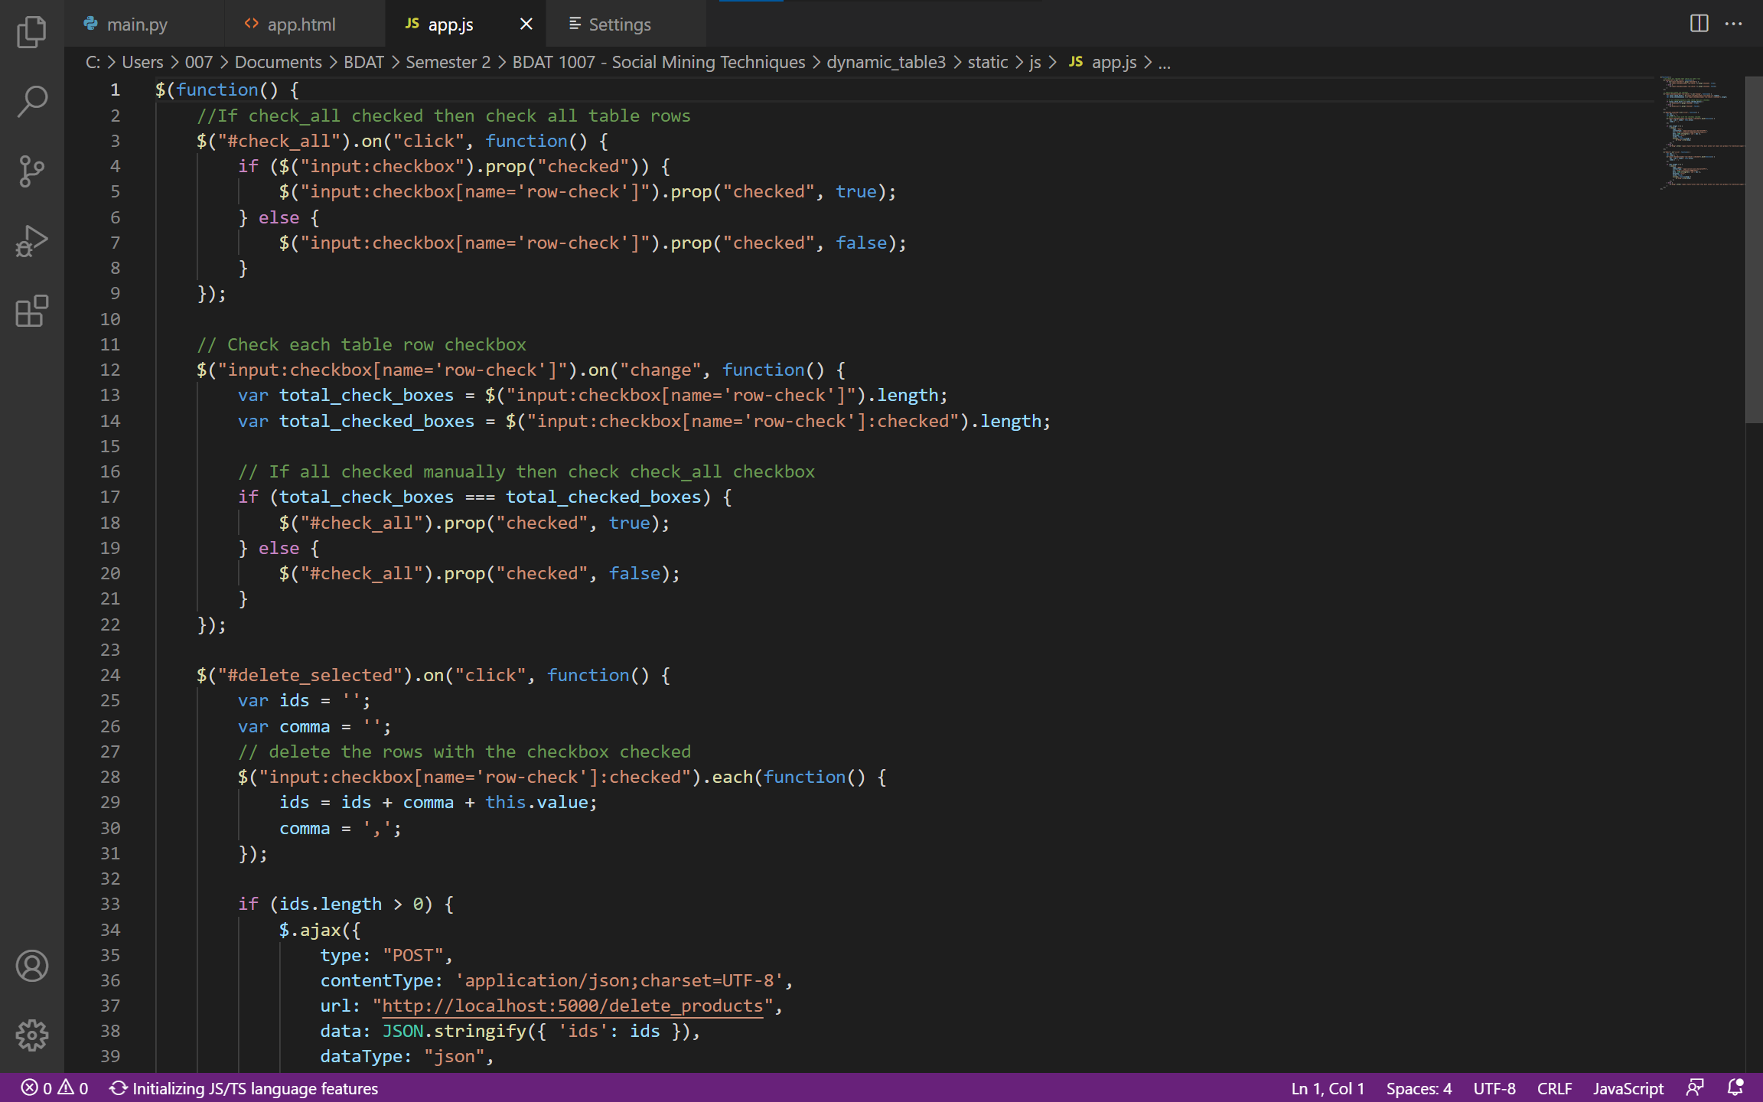
Front End For Web App Part 8

Slide 32
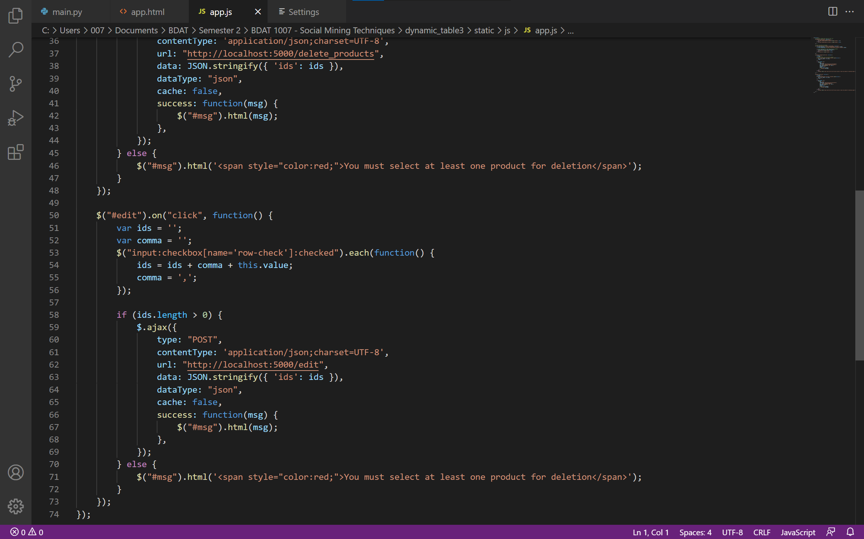
Front End For Web App Part 9

Slide 33
CRUD

Slide 34
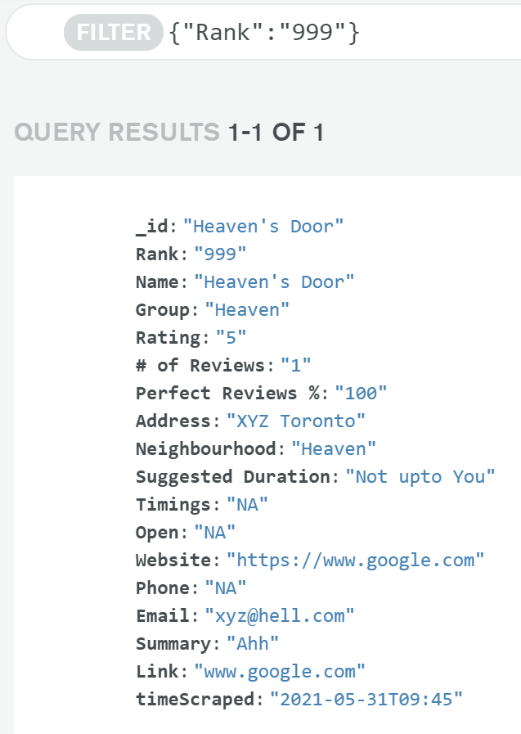
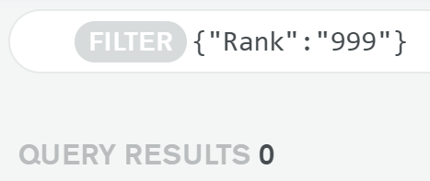
Add Entry
Delete Entry

Slide 35
YouTube video link
https://youtu.be/nJ1DaMc7zYE

Slide 36
RESOURCES
https://www.tripadvisor.in/Attractions-g155019-Activities-a_allAttractions.true-Toronto_Ontario.html
Bootstrap · The world's most popular mobile-first and responsive front-end framework. (getbootstrap.com)
jQuery
DataTables example - Bootstrap 3

Slide 37
THANK YOU

